Slide 1

Chapter 5
Reliability of Systems
Hey! Can you tell us how to analyze complex systems?
Serial Configuration
Parallel Configuration
Combined Series-Parallel
Chapter 5
Notes:
There are two approaches to modeling the reliability of complex systems. We can attempt to capture the observed failure distribution of the system itself by collecting and analyzing its failure data. Or, we can determine the failure distribution of each component and then determine the system failure distribution based upon the configuration of the components. It is this second approach when the components are mutually independent that is the subject of this chapter. Certain dependent situations will be addressed in Chapter 6.

Slide 2
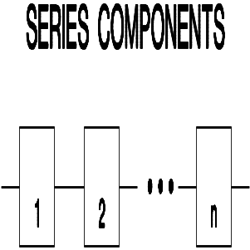
Serial Configuration
Reliability
Block Diagram
E₁ = the event, component 1 does not fail, and
E₂ = the event, component 2 does not fail, then
P{E₁} = R₁ and P{E₂} = R₂ where
R₁ = the reliability of component 1, and
R₂ = the reliability of component 2.
Therefore assuming independence:
R_{s} = P{E₁ ∩ E₂} = P{E₁} P{E₂} = R₁ R₂
Chapter 5
Notes:
Components within a system can be related in a serial or parallel fashion. If n components are serially related then the failure of any one (or more) of the components results in a system failure. This leads to the multiplicative relationship of their reliability functions to the system reliability. Applying some basic rules of probability theory under the independence assumption leads to this result. By the way, the diagram showing the serial relationship is called a reliability block diagram. This is a useful way of depicting the reliability configuration of the system.

Slide 3
Multiple Components in Series
Generalizing to n mutually independent components in series;
R_{s}(t) = R₁(t) x R₂(t) x ... x R_{n}(t)
and R_{s}(t) ≤ min {R₁(t), R₂(t), ..., R_{n}(t)}
Chapter 5
Notes:
At time t, for the system to be functioning each of components must be functioning. Since R_{i}(t) is the probability that the i^{th} component is functioning at time t, then the product of all n reliabilities gives the desired result (i.e. component 1 is functioning, component 2 is functioning, component 3 is functioning etc.). State in words the meaning of the above inequality. Why is it true?

Slide 4
Component Count vs. System Reliability
Component Number of Components
Reliability 10 100 1000
.900 .3487 . 266x10⁻⁴ . 1748x10⁻⁴⁵
.950 .5987 .00592 . 5292x10⁻²²
.990 .9044 .3660 . 443x10⁻⁴
.999 .9900 .9048 .3677
System Reliability
Chapter 5
Notes:
Multiplication in action: For systems having a large number of components, the individual component reliabilities must be large for the system to be reliable.

Slide 5
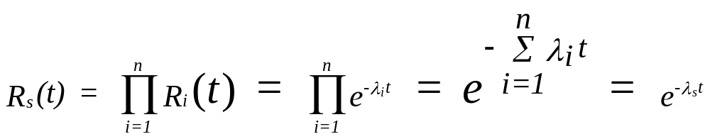

Constant Failure Rate Components
Chapter 5
Notes:
If all the components are exponential (CFR), then the system is also exponential. A result we had seen earlier.

Slide 6
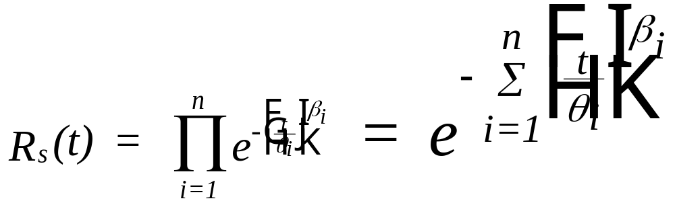
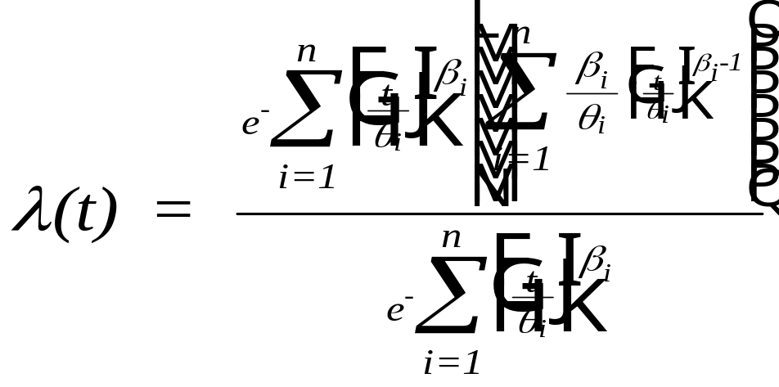
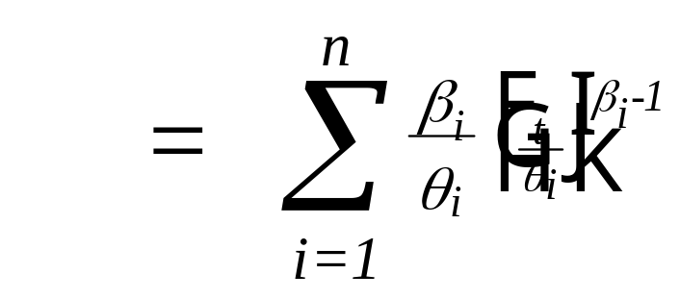
Weibull Components
Chapter 5
Notes:
If all the components are Weibull, then the system is not necessarily Weibull. Do you recall under what conditions, the system will be Weibull?

Slide 7
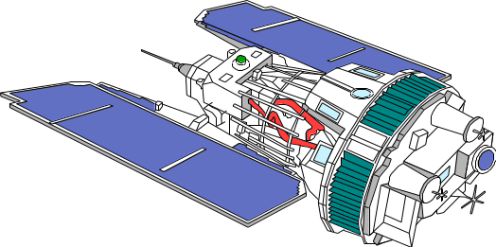
Components in Series - Example
A communications satellite consists of the following components:
Probability Shape Characteristic
Component Distribution Parameter life
Power unit Weibull 2.7 43,800 hr.
Receiver Weibull 1.4 75,000 hr.
Transmitter Weibull 1.8 68,000 hr.
Antennae Exponential MTTF = 100,000 hr.
Chapter 5
Notes:
In general, components can have a variety of distributions. Regardless, if we multiply their reliabilities we will get the system reliability. Without looking ahead, what is the system reliability at two years (17,520 hours at 24/7)?

Slide 8
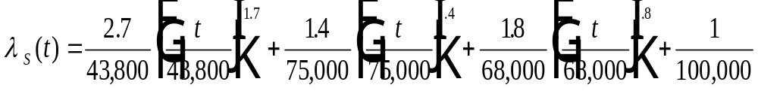
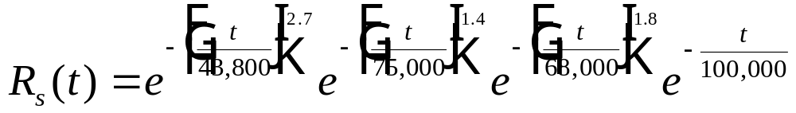
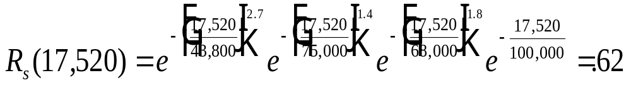
Components in Series - Example
Chapter 5
Notes:
Is the reliability acceptable? How would you find the system MTTF? Don’t find it, just think about how to find it.

Slide 9

Class Exercise
The failure distribution of the main landing gear of a commercial airliner is Weibull with a shape parameter of 1.6 and a characteristic life of 10,000 landings. The nose gear also has a Weibull distribution with a shape parameter of .90 and a characteristic life of 15000 landings. What is the reliability of the landing gear system if the system is to be overhauled after
1000 landings?
Chapter 5
Notes:
This would seem like an important reliability to know. Can you find what it is?

Slide 10
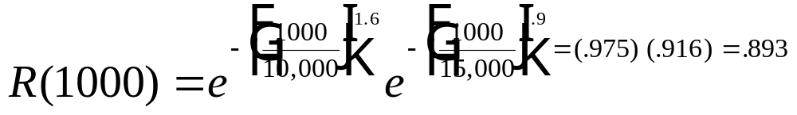
Class Exercise - solution
Animated
Chapter 5
Notes:
Perhaps we should schedule overhauls more frequently. Can we assume that an overhaul of the landing gear system will restore it to “as good as new.” That is, we set the time clock on the system back to zero. If not, what can we conclude?

Slide 11
Parallel Configuration
R_{s} = P{E1 ∪ E2} = 1 - P{(E1 ∪ E2)^{c} }
= 1 - P{E1^{c} ∩ E2^{c} }
= 1 - P{E1^{c} } P{E2^{c} } = 1 - (1-R₁) (1-R₂)
where E1 = event, component 1 does not fail
E2 = event, component 2 does not fail, and
Pr{E1} = R₁ and Pr{E2} = R₂
R₁
R₂
R_{n}
The probability at least one component does not fail!
Chapter 5
Notes:
A parallel or redundant relationship among components will require that all parallel components fail before the system will fail. The easiest way to find the system reliability is to first compute the probability that all components fail and then subtract that number from one (1.0). Why does this work?

Slide 12
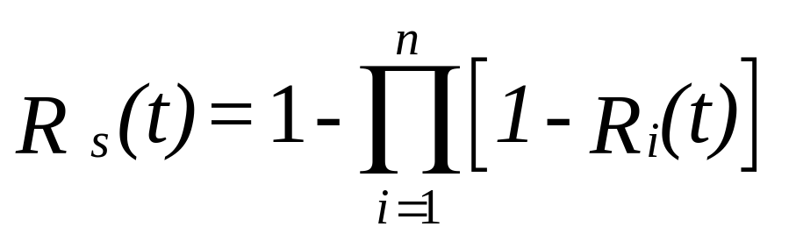
Parallel Configuration - Generalization
R_{s} (t) >= max {R₁(t), R₂(t), …, R_{n}(t)}
Chapter 5
Animated
Notes:
What is the quantity in brackets? What is its product? State in words the meaning of the inequality. Give at argument showing why it is true?

Slide 13
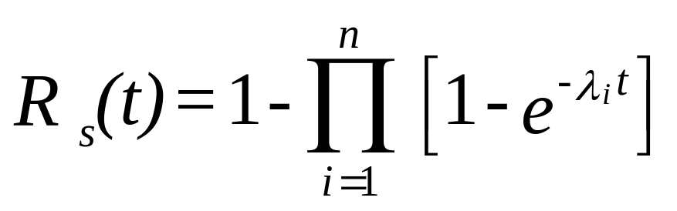
Parallel Configuration - CFR Model
Chapter 5
Notes:
For n parallel components having exponential distributions, the system failure distribution will not be exponential. Observe how easily the system MTTF is derived by integrating the system reliability function. We will see more of this in the next chapter. Now write simplified expressions for R(t) and the MTTF if all components have the same constant failure rate.

Slide 14
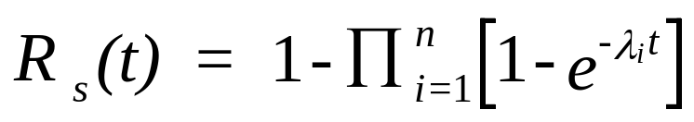
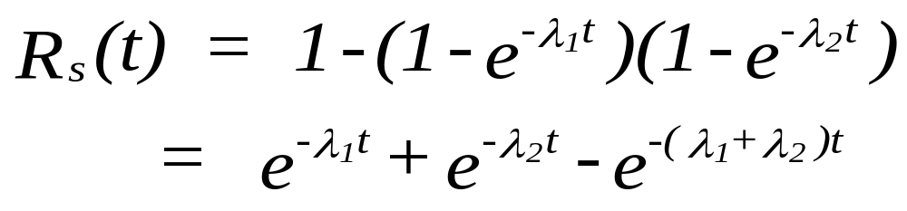
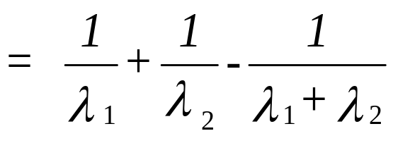
Parallel Configuration – 2-component CFR Model
For n = 2:
Chapter 5
Notes:
For n parallel components having exponential distributions, the system failure distribution will not be exponential. Observe how easily the system MTTF is derived by integrating the system reliability function. We will see more of this in the next chapter. Now write simplified expressions for R(t) and the MTTF if all components have the same constant failure rate.

Slide 15
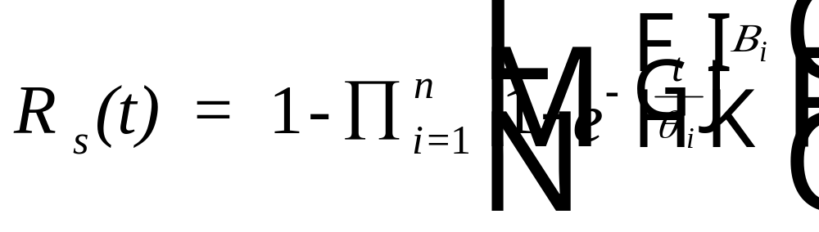
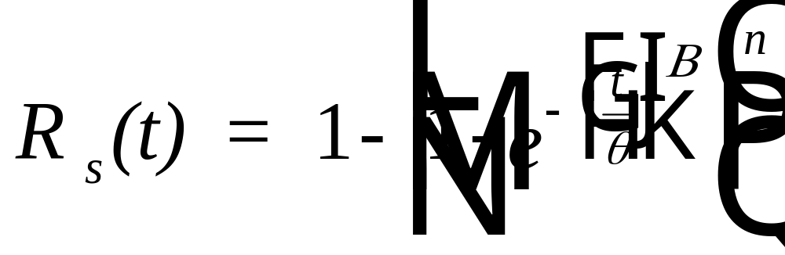
Parallel Configuration - Weibull Model
If n identical Weibull components are in parallel:
Chapter 5
Notes:
My gosh, n parallel, independent, Weibull components.

Slide 16
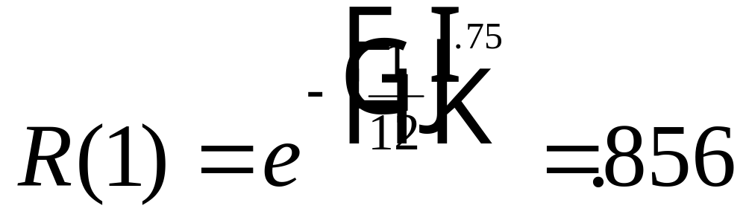
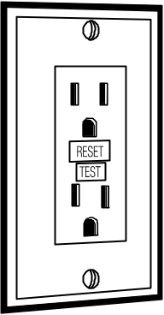
Parallel Configuration - Example
A circuit breaker has a Weibull failure distribution (against a power surge) with beta equal to .75 and a characteristic life of 12 years.
Determine the one year reliability if two identical circuit
breakers are redundant.
Chapter 5
Notes:
Physically how are two circuit breakers wired in order for them to be redundant? What is the resulting reliability?

Slide 17
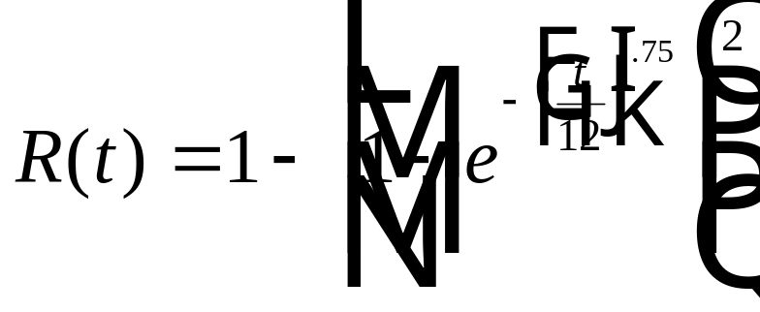
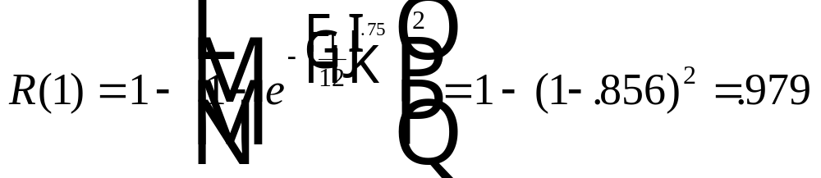
Parallel Configuration – Example Solution
Two redundant breakers have a reliability function of:
Question: how are two redundant circuit breakers physically configured?
Chapter 5
Notes:
Congratulations, I am sure you got the same value.

Slide 18
Combined Series - Parallel Systems
R₁
R₃
R₂
R₆
R₄
R₅
Chapter 5
Notes:
“What happens if a system has both serial and parallel relationships among the components,” you ask. We attempt to break the system down in sub-assemblies consisting of two or components that are all either serial or parallel related. Then we put the sub-assemblies together that are all either serial or parallel related, etc. But wait, this is best illustrated by an example. Use the animation on the next several slides to see how this reliability network is solved.

Slide 19
Combined Series - Parallel Systems
B
A
R₁
R₃
R₂
R₆
C
R₄
R₅
Chapter 5
Notes:
“What happens if a system has both serial and parallel relationships among the components,” you ask. We attempt to break the system down in sub-assemblies consisting of two or components that are all either serial or parallel related. Then we put the sub-assemblies together that are all either serial or parallel related, etc. But wait, this is best illustrated by an example. Use the animation on the next several slides to see how this reliability network is solved.

Slide 20
Combined Series - Parallel Systems
A
R₁
R_{A} = [ 1 - (1 - R₁) (1 - R₂ )]
R₂
Chapter 5
Notes:
We first find the reliability of subassembly A. Then form subassembly B and find its reliability.

Slide 21
Combined Series - Parallel Systems
A
R_{A} = [ 1 - (1 - R₁) (1 - R₂ )]
R₁
R₂
B
A
R₁
R₃
R_{B} = R_{A} R₃
R₂
Chapter 5
Notes:
We first find the reliability of subassembly A. Then form subassembly B and find its reliability.

Slide 22
Combined Series - Parallel Systems
C
R_{C} = R₄ R₅
R₄
R₅
R_{B}
R₆
R_{C}
R_{s} = [1 - (1 - R_{B}) (1 - R_{c}) ] R₆
Chapter 5
Notes:
Separately find the reliability of subassembly C. Now B and C are in parallel with their assembly in series with component 6. And you thought this was going to be hard!

Slide 23
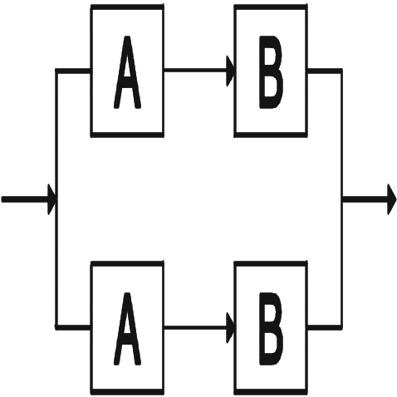
High Level Redundancy
R_{high} = 1 - (1-R² )² = 1 - [1-2 R² +R⁴ ] = 2R² - R⁴
Chapter 5
Animated
Notes:
Here is an interesting concept. High level versus low level redundancy. Jump ahead to the next slide and look at the low level configuration. Now describe the difference in words. From the reliability block diagram, you should be able to compute the high level redundancy reliability.

Slide 24
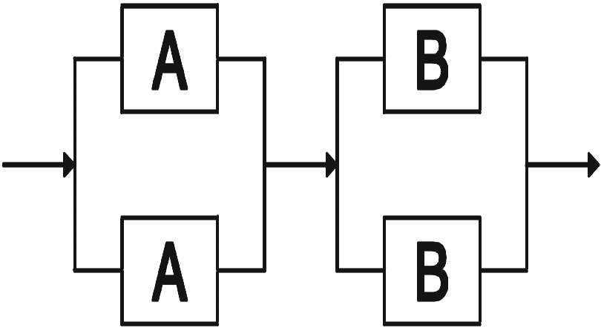
Low Level Redundancy
R_{LOW} = [1-(1-R)²]² = [1-(1-2R+R²)]² = (2R-R²)²
Chapter 5
Notes:
Now compute the low level redundancy reliability. Which do you think has the greater reliability? Why?

Slide 25
High vs Low Level Redundancy
R_{low} - R_{high} = (2R - R²)²- (2R² - R⁴)
= R² (2-R)² - R² (2 - R²)
= R² [4 - 4R + R² - 2 + R²]
= 2 R² [R² - 2R + 1] = 2 R² (R - 1)² ≥ 0
Chapter 5
Notes:
Assuming each of the components has the identical reliability R, a little algebra produces the above result. Now which type of redundancy has the better reliability? Under what conditions will they be the same? What are the important assumptions that lead to these conclusions?

Slide 26
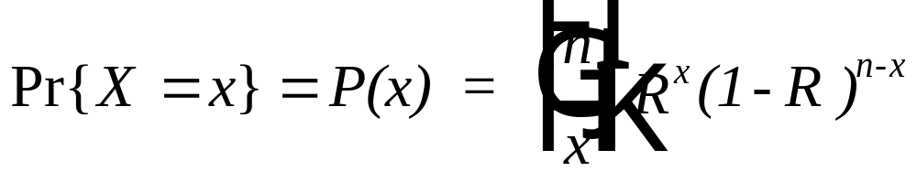
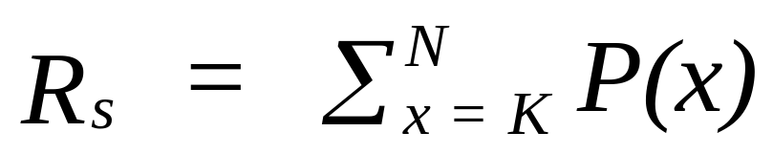
k-out-of-n Redundancy
Let n = the number of redundant, identical and independent
components each having a reliability of R.
Let X = a random variable, the number of components (out of n components) operating. Then
If k (<= n) components must operate for the system to operate:
Chapter 5
Notes:
A generalization on the concept of redundancy is to require any k of the n components to operate for the system to operate. In other words, there is a minimum number, k, that must not fail. When the N-k+1 component fails then the system fails. If all components are identically distributed, then the reliability can be found using the binomial probability distribution. Recall that the a binomial random variable is defined to be the number of successes among n independent trials. A trial is a component and a success is operating at time t.

Slide 27
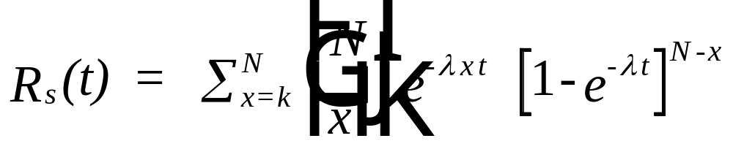
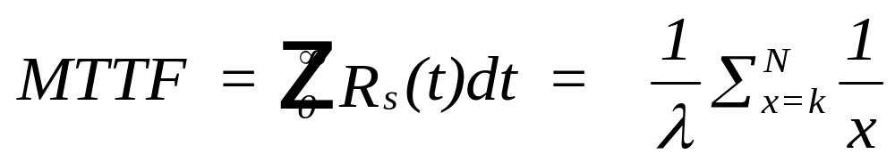
k-out-of-n Redundancy
Exponential Distribution
Chapter 5
Notes:
If each component has the same exponential failure distribution, the above results hold. Would you like to try to derive the MTTF in this case? No?

Slide 28
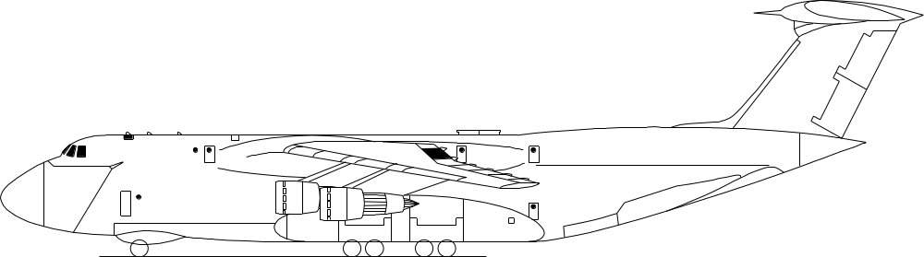
A Very Good Example
Out of the 12 identical AC generators on the C-5 aircraft, at least
9 of them most be operating in order for the aircraft to complete
its mission. Failures are known to follow an exponential
distribution with a mean of 100 operating hours. What is the
reliability of the generator system over a 10 hour mission? Find
the MTTF.
Chapter 5
Notes:
Test your understanding on this example.

Slide 29
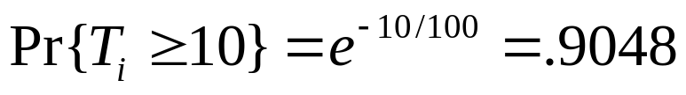
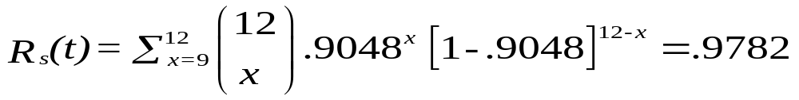

A Very Good Solution
Let T_{i} = time to failure of the i^{th} generator
Chapter 5
Notes:
Doesn’t it feel good when you get the correct answer?

Slide 30
Complex Configurations
a. linked network:
A
C
E
B
D
Chapter 5
Notes:
“Can all reliability block diagrams be solved by identifying pure serial and parallel relationships?” you wonder. The answer is no. The above block diagram is an example where component E creates some difficulty. Component E participates in both a serial and parallel relationship that cannot be analyzed separately. Such a block diagram is called a linked network. One approach to solving such a network is known as decomposition. Decomposition consists of solving the network twice. Once when E is assumed to have failed and once when E is assumed to be 100 percent reliable.

Slide 31
Decomposition Approach
(b) Component E does not fail, R_{E}:
A
C
B
D
R_{(b)} = [1-(1-R_{A})(1-R_{B})][1-(1-R_{C})(1-R_{D})]
Chapter 5
Notes:
Here is the corresponding block diagram when E is assumed to 100 percent reliable. This will occur with a probability of R(E). We find the system reliability, R_{(b)} for this case.

Slide 32
Decomposition Approach
(c ) Component E fails (1-R_{E}):
A
C
B
D
R_{(c)} = 1-(1-R_{A}R_{C}) (1-R_{B} R_{D})
Chapter 5
Notes:
Here is the corresponding block diagram when E is assumed to have failed. This will occur with a probability of 1- R(E). We find the system reliability, R_{(c)} for this case.

Slide 33
Decomposition Approach
R_{S} = R_{E} R_{(b)} + (1 - R_{E} ) R_{(c )}
if R_{A} = R_{B} = .9, R_{C} = R_{D} = .95, and R_{E} = .80, then
R_{(b)} = [1-(1-.9)²] [1-(1-.95)²] = .99 x .9975 = .9875
R_{(c )}= 1 - [1-(.9) (.95)]² = .978975
R_{s} = .8 (.9875) + (1-.8) (.978975) = .9858
Chapter 5
Notes:
We now put the two cases together by computing the weighted average of the reliability of the two networks. The weights are the probability of observing the corresponding network; i.e. R(E) and 1-R(E).

Slide 34
Enumeration Method
S = success; F = failure
A B C D E System Probability
S S S S S S .58482
F S S S S S .06498
S F S S S S .06498
S S F S S S .03078
S S S F S S .03078
S S S S F S .146205
F F S S S F
S F F S S S .00342
S S F F S F
S S S F F S .007695
TOTAL .9858
Chapter 5
Notes:
An alternative to the decomposition method is an exhaustive enumeration of all possible combinations of component failures and non-failures (successes). For each combination, a determination is made as to whether the system will fail or not fail based upon its configuration (reliability block diagram). By computing and then summing the probability of all combination resulting in a system non-failure, the system reliability is found. If there are n components composing the system, then there are 2^{n} combinations to be analyzed.

Slide 35
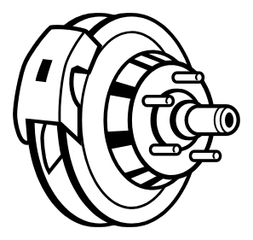
Example – Automotive Braking System
WC1
BP1
WC2
BP2
M
WC3
BP3
C
WC4
BP4
Chapter 5
Notes:
More complex systems may have two or more linked components. In this example, both BP3 and BP4 are linked. This generates four cases: both operate, neither operates, BP3 operates and BP4 fails, and BP4 operates and BP3 fails.
Notation:
M – master cylinder
C – cable (parking brake)
WC – wheel cylinder
BP – brake pad

Slide 36
WC1
BP1
WC2
BP2
M
WC3
BP3
C
WC4
Case I. BP3 fails and BP4 is operational.
1. P_{I} = [1 - R(BP)] R(BP)
2. R_{f} = R(M){1 - [1 - R(WC) R(BP)]² [1 - R(WC)]}.
3. R{mechanical} = R(C)
4. These two subsystems operate in parallel, therefore,
R_{I} = 1 - [1 - R_{f} ] [1 - R(C)].
Case II. BP4 fails and BP3 is operational.
Then P_{II} = P_{I} and R_{II} = R_{I} (by symmetry of the network and assuming identical reliabilities)
Chapter 5
Notes:
Cases I and II. Study the resulting network and its solution. In each network, P_{i} where i = I, II, III, and IV, is the probability of that network being observed and R_{i} where i = I, II, III, and IV, is its system reliability.

Slide 37
WC1
BP1
WC2
BP2
M
WC3
BP3
C
WC4
BP4
Case III. BP3 and BP4 have failed.
1. P_{III} = [1 - R(BP)]²
2. Cable system has failed.
3. R_{III} = R(M) {1 - [1 - R(WC) R(BP)]² }
Chapter 5
Notes:
Case III. When both have failed, the rear braking system including the cable system is non-functional.

Slide 38
WC1
BP1
WC2
BP2
M
WC3
C
WC4
Case IV. Both BP3 and BP4 are operational.
1. P_{IV} = [R(BP)]²
2. R_{f} = R(M){1 - [1 - R(WC) R(BP)]2 [1 - R(WC)]2}.
3. R{cable system} = R(C)
4. R_{IV} = 1 - [1 - Rf] [1 - R(C)]
The overall system reliability can now be found from:
R_{S} = P_{I} R_{I} + P_{II} R_{II} + P_{III} R_{III} + P_{IV} R_{IV}
Chapter 5
Notes:
Case IV. How many cases would have to be analyzed if there were 3 linked components? Can you work this problem using the enumeration method? How many combinations would you need to analyze then? Which method do you think is easier (fewer calculations).

Slide 39

A Common Everyday Reliability Block Diagram to Solve
R_{E}=.7
R_{A}=.8
R_{D}=.95
R_{F}=.8
R_{B}=.9
R_{C}=.9
Help! Where can I find
a common everyday
reliability block diagram?
Chapter 5
Notes:
Here is a typical, common everyday reliability block diagram. What is the system reliability? Be sure you can solve this type of a problem before you continue to the next exciting chapter!

Slide 40

A Common Everyday Reliability Block Diagram – solved
R_{E}=.7
R_{A}=.8
R_{D}=.95
R_{F}=.8
R_{B}=.9
R_{C}=.9
.81
1-(1-.7)(1-.8) = .94
1-(1-.8)(1-.81) = .962
R_{s} = (.962) (.95) (.94) = .859066
Notes:
Here is a typical, common everyday reliability block diagram. What is the system reliability? Be sure you can solve this type of a problem before you continue to the next exciting chapter!

Slide 41
Summary
Series Configuration
Parallel Configuration
Combined Series-Parallel Configuration
High / Low Level Redundancy
K out-of-n Redundancy
Complex Configurations – linked networks
Chapter 5

